Slide 1
Week 2 In-class
04 Moment
05 Equilibrium of rigid body

Slide 2
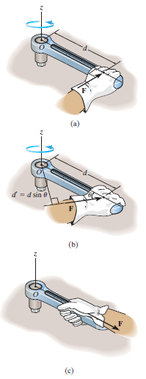
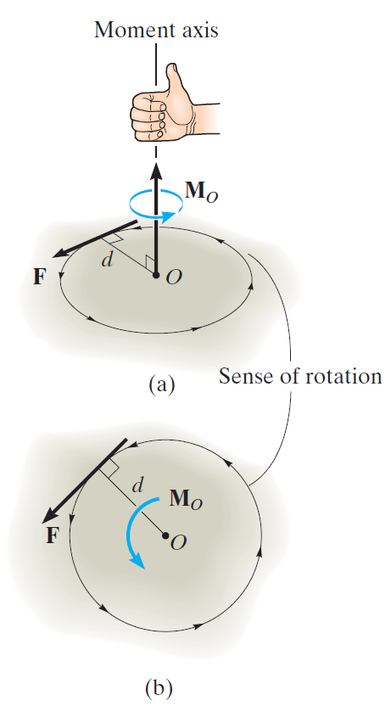
Moment
Vector
Magnitude
Direction (not obvious)
How can we generate the moment?

Slide 3
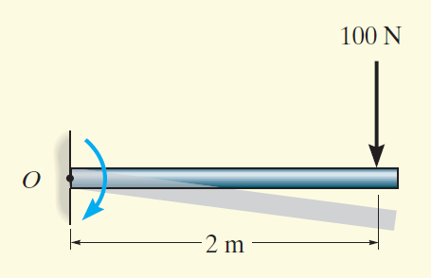
Exercise
Determine the moment of the force about point O
Magnitude
Direction
Static?

Slide 4
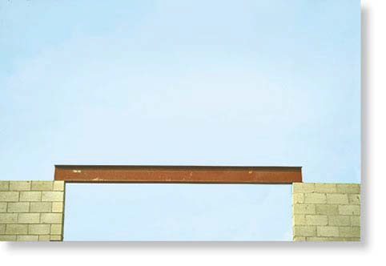
Exercise
Describe all the static forces and moments
Reaction forces F_{a} and F_{b}
Which one is bigger intuitively?
Think about extreme case
F_{a}
F_{b}

Slide 5
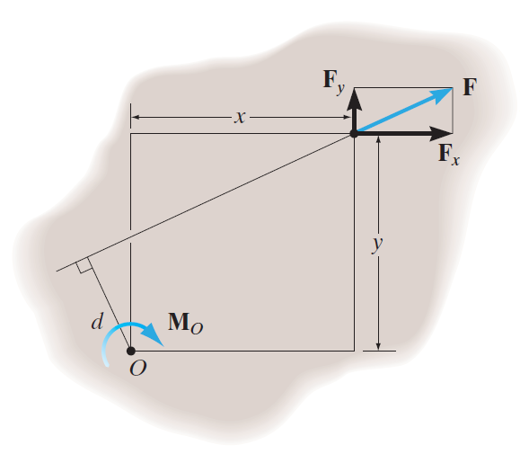

Slide 6


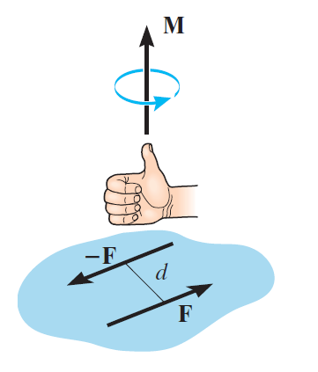
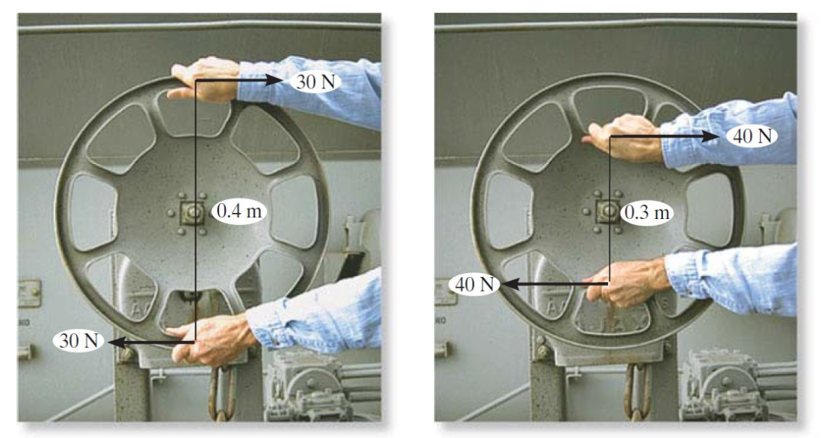
Moment of a Couple

Slide 7
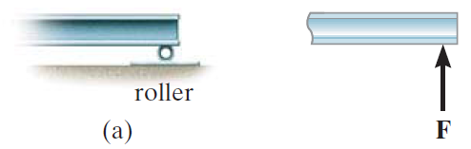
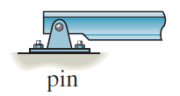
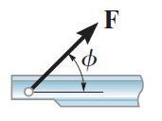
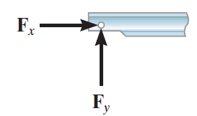
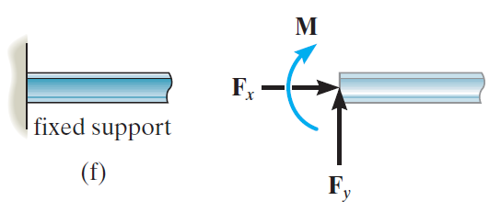
Free-Body Diagrams

Slide 8
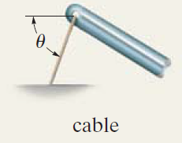
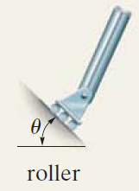
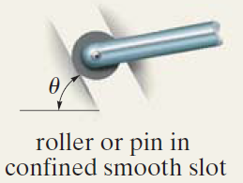
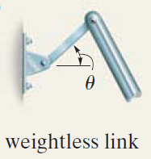
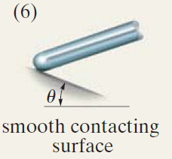
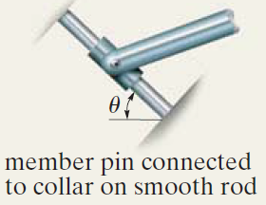
Free-Body Diagrams

Slide 9
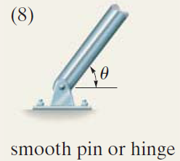
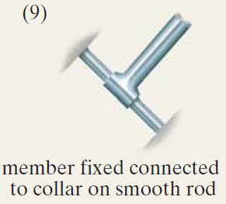
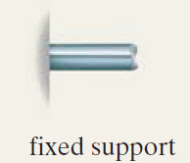

Slide 10
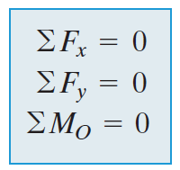
Equations of Equilibrium
Equivalent to solving the system of linear equations

Slide 11
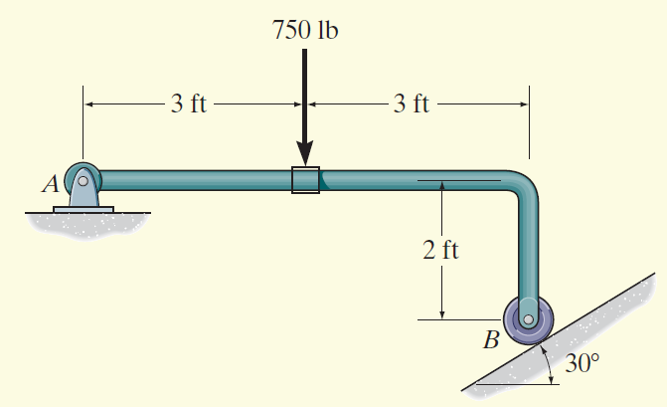
Exercise
Determine the horizontal and vertical components of reaction on the member at the pin A, and the normal reaction at the roller B.

Slide 12
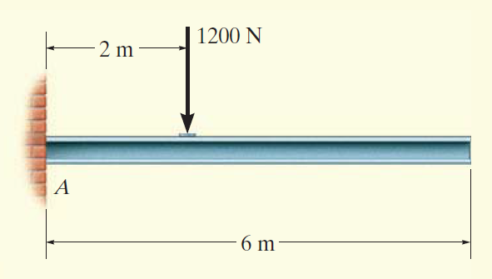
Exercise
Draw the free-body diagram of the uniform beam. The beam has a mass of 100 kg.

